Slide 1



Noida Institute of Engineering and Technology, Greater Noida
CLOUD AND EDGE COMPUTING
Unit: 3
Cloud Architecture, Services & Storage
Jaya Nidhi Vashishtha
Assistant Professor, CSE-IOT
NIET, Greater Noida
B Tech (CSE-IOT)- 6th Sem

Slide 2
Syllabus
UNIT-III Cloud Architecture, Services and Storage: 8 HOURS Layered Cloud Architecture Design – NIST Cloud Computing Reference Architecture – Public, Private and Hybrid Clouds – laaS – PaaS – SaaS – Architectural Design Challenges – Cloud Storage – Storage-as-a-Service – Advantages of Cloud Storage – Cloud Storage Providers – S3, RDS, EBS.

Slide 3
Prerequisites
The student should have knowledge of:
Basics of OS.
Basic concepts of computer fundamentals of computer system and cloud and edge computing

Slide 4
Recap
Service Oriented architecture : Rest & Systems of system​
Web Services : Publish Subscribe Model​
Basics of Virtualization : Types & Implementation​
Structures : Tools & Mechanisms ​
Virtualization of CPU – Memory- I/O devices​
Virtualization : Support & Disaster Recovery​

Slide 5
Unit Objective
To study the Layered Cloud Architecture Design.
To study the basic concepts about NIST Cloud Architecture Design .
Understanding the Architecture Design Challenges .
Understanding of different types of challenges.
Overview of Cloud Storage Providers.

Slide 6

Unit Contents
Layered Cloud Architecture Design
NIST Cloud Computing Reference Architecture
Public Private & Hybrid Cloud
IaaS – PaaS - SaaS
Architectural Design Challenges
Cloud Storage
Storage as a Service
Advantages of Cloud Storage
Cloud Storage Providers : S3,RDS,EBS

Slide 7
Layered Cloud Architecture Design
Layered Cloud Architecture Design
● The architecture of a cloud is developed at three layers: infrastructure, platform and application.
● These three development layers are implemented with virtualization and standardization of hardware and software resources provisioned in the cloud.
● The services to public, private and hybrid clouds are conveyed to users through networking support over the Internet and intranets involved.

Slide 8
Layered Cloud Architecture Design
Layered Cloud Architecture Design
● It is clear that the infrastructure layer is deployed first to support IaaS services.
● This infrastructure layer serves as the foundation for building the platform layer of the cloud for supporting PaaS services.
● In turn, the platform layer is a foundation for implementing the application layer for SaaS applications.

Slide 9
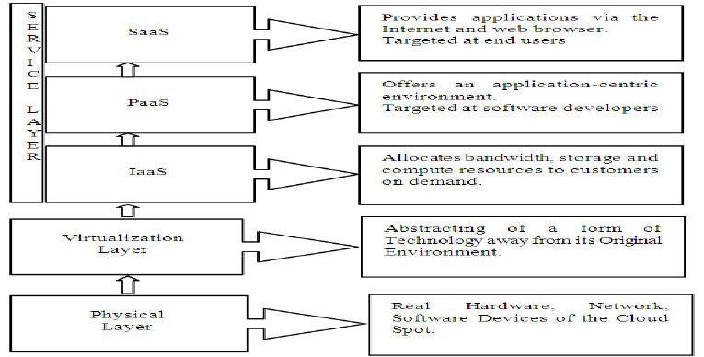
Layered Cloud Architecture Design
Fig: 1 Layered Cloud Architechture Design

Slide 10
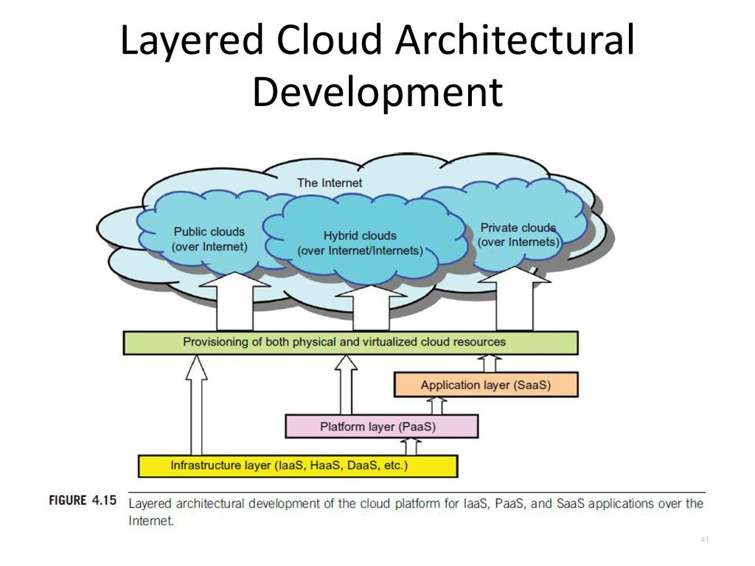
Layered Cloud Architecture Design
Fig: 2 Layered Cloud Architechtural Development Design

Slide 11
Recap
Layered Cloud Architecture Design
The architecture of a cloud is developed at three layers: infrastructure, platform and application.
These three development layers are implemented with virtualization and standardization of hardware and software resources provisioned in the cloud.
The services to public, private and hybrid clouds are conveyed to users through networking support over the Internet and intranets involved.

Slide 12
Daily Quiz
1. What is the primary purpose of a layered cloud architecture? a) To ensure all cloud services run on the same layer b) To organize cloud components into separate layers for better management and scalability c) To limit cloud services to only one deployment model d) To restrict communication between cloud users
Answer: b) To organize cloud components into separate layers for better management and scalability
3. In a layered cloud architecture, which layer provides runtime environments and development tools for applications? a) Software as a Service (SaaS) Layer b) Infrastructure as a Service (IaaS) Layer c) Platform as a Service (PaaS) Layer d) Security Layer
Answer: c) Platform as a Service (PaaS) Layer
4. How does the Security Layer function in cloud architecture? a) It controls user authentication, data encryption, and access management b) It handles only physical security in data centers c) It prevents all external access to cloud services d) It only monitors network traffic without protecting data
Answer: a) It controls user authentication, data encryption, and access management
2. Which layer in the cloud architecture is responsible for managing virtualized computing resources? a) Application Layer b) Platform Layer c) Infrastructure Layer d) User Layer
Answer: c) Infrastructure Layer

Slide 13
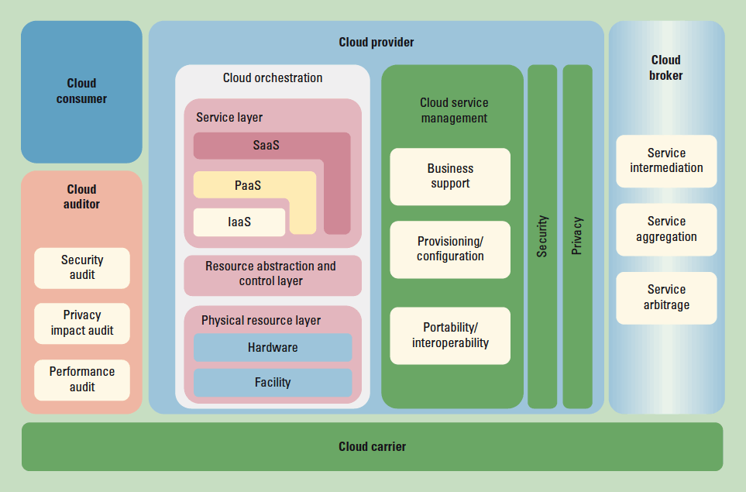
NIST Cloud Computing Reference Architecture

Slide 14
NIST Cloud Computing Reference Architecture
NIST Cloud Computing reference architecture defines five major performers:
Cloud Provider
Cloud Carrier
Cloud Broker
Cloud Auditor
Cloud Consumer

Slide 15
NIST Cloud Computing Reference Architecture
Cloud Service Providers: A group or object that delivers cloud services to cloud consumers or end-users. It offers various components of cloud computing. :
IaaS Providers
SaaS Providers
PaaS Providers
2. Cloud Carrier: The mediator who provides offers connectivity and transport of cloud services within cloud service providers and cloud consumers.
3. Cloud Broker: An organization or a unit that manages the performance, use, and delivery of cloud services by enhancing specific capability and offers value-added services to cloud consumers.
4. Cloud Auditor: An entity that can conduct independent assessment of cloud services, security, performance, and information system operations of the cloud implementations.

Slide 16
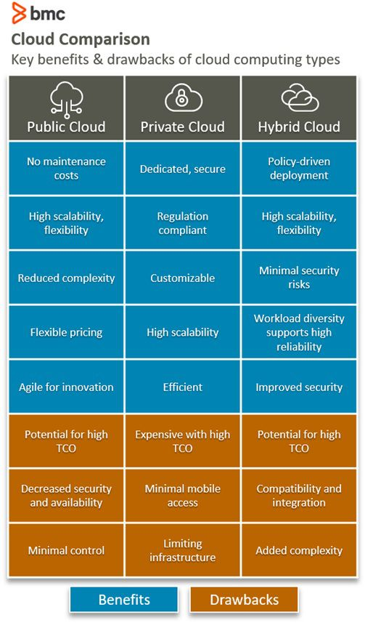
Public Private & Hybrid Cloud
The term cloud computing spans a range of classifications, types, and architecture models. Cloud computing can be categorized into three general types:
Public cloud is cloud computing that’s delivered via the internet and shared across organizations.
Private cloud is cloud computing that is dedicated solely to your organization.
Hybrid cloud is any environment that uses both public and private clouds.

Slide 17
IaaS – PaaS - SaaS
There are 3 main types of cloud computing as-a-service options and each one covers a degree of management for you: infrastructure-as-a-service (IaaS), platform-as-a-service (PaaS), and software-as-a-service (SaaS).
IaaS
Infrastructure-as-a-service, or IaaS, It’s a pay-as-you-go service where a third party provides you with infrastructure services, like storage and virtualization, as you need them, via a cloud, through the internet.
PaaS
Platform-as-a-service (PaaS) is another step further from full, on-premise infrastructure management.
SaaS
Software-as-a-service (SaaS), also known as cloud application services, is the most comprehensive form of cloud computing services, delivering an entire application that is managed by a provider, via a web browser.

Slide 18
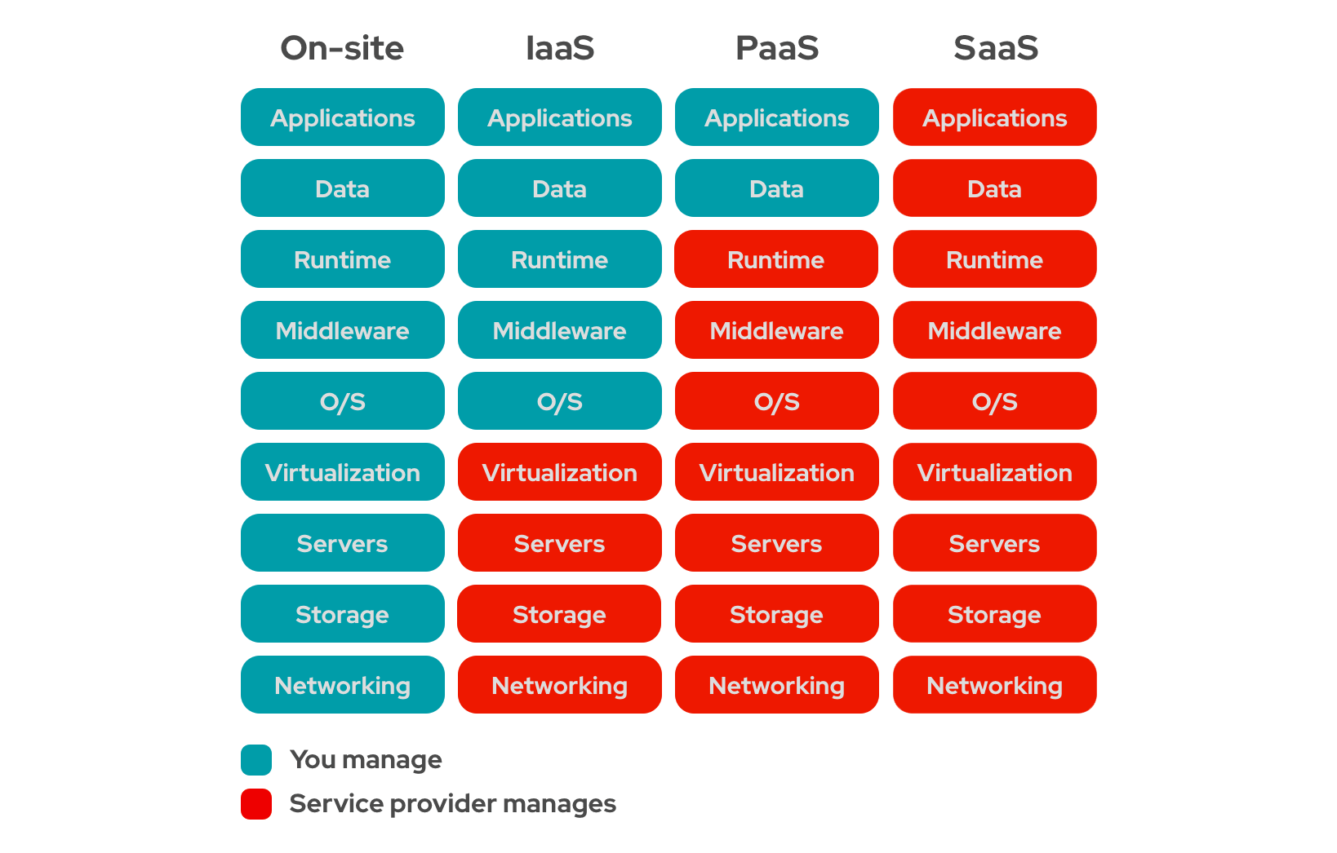
IaaS – PaaS - SaaS

Slide 19
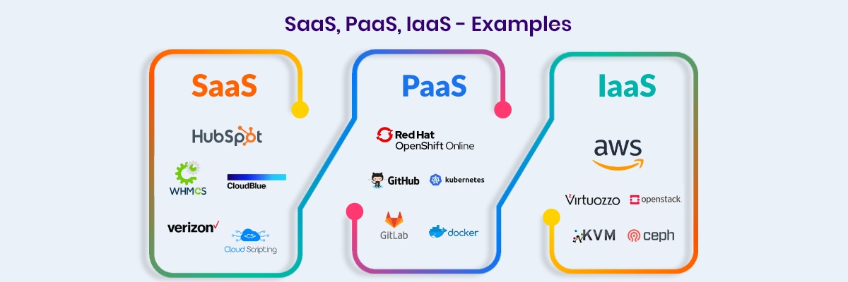
IaaS – PaaS - SaaS

Slide 20
Recap
NIST Cloud Computing Reference Architecture
Public, Private and Hybrid Clouds
IaaS – PaaS – SaaS

Slide 21
Daily Quiz
1. According to NIST, which of the following is NOT a key role in the Cloud Computing Reference Architecture? a) Cloud Provider b) Cloud Consumer c) Cloud Auditor d) Cloud Hardware Manufacturer
Answer: d) Cloud Hardware Manufacturer
3. What is a primary benefit of a Hybrid Cloud? a) Complete reliance on on-premises hardware b) A mix of public and private cloud benefits for flexibility and scalability c) Reduced security and control over data d) Requires minimal cloud management
Answer: b) A mix of public and private cloud benefits for flexibility and scalability
2. In the NIST Cloud Computing Reference Architecture, what is the primary responsibility of the Cloud Broker? a) Managing cloud infrastructure b) Acting as an intermediary to optimize cloud services for consumers c) Auditing cloud security policies d) Storing customer data in private servers
Answer: b) Acting as an intermediary to optimize cloud services for consumers
4. Which of the following best describes IaaS? a) A service that provides fully managed applications b) A cloud model that offers virtualized computing resources such as servers, storage, and networking c) A development environment for building applications d) A security framework for cloud networks
Answer: b) A cloud model that offers virtualized computing resources such as servers, storage, and networking

Slide 22
Daily Quiz
5. Which of the following is an example of SaaS? a) Amazon EC2 b) Microsoft Azure Virtual Machines c) Google Docs d) Kubernetes
Answer: c) Google Docs
7. What is a key characteristic of SaaS? a) Requires customers to manage infrastructure and networking b) Provides applications over the internet without the need for installation c) Limits accessibility to a single user d) Requires extensive software coding knowledge
Answer: b) Provides applications over the internet without the need for installation
6. What is the main advantage of PaaS? a) Provides a ready-to-use development platform with built-in tools and frameworks b) Eliminates the need for cloud computing infrastructure c) Focuses only on cloud networking and security d) Requires users to manually configure all system resources
Answer: a) Provides a ready-to-use development platform with built-in tools and frameworks

Slide 23
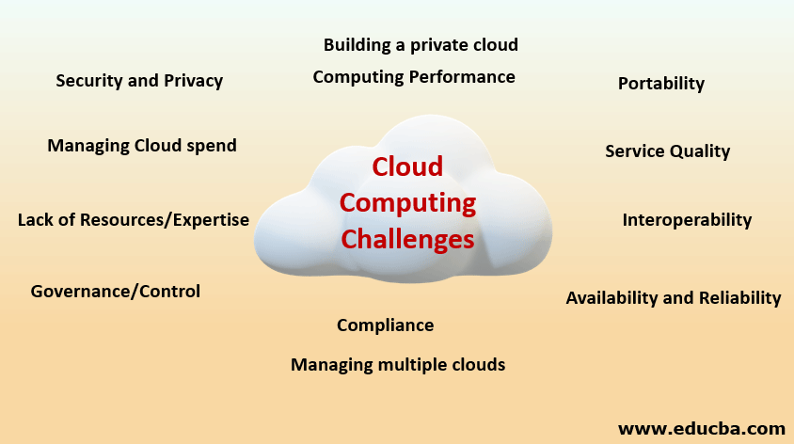
Architectural Design Challenges
Architectural Design Challenges
Portability. Challenge to cloud computing those applications should easily be migrated from one cloud provider to another.
Cost.
Interoperability.
Performance Challenges.
Downtime.
Multi-Cloud Environments
High Dependence on Network.
Fig: 3 Cloud Computing Challenges

Slide 24
Cloud Storage
What is Cloud Storage?
Cloud storage is a cloud computing model that enables storing data and files on the internet through a cloud computing provider that you access either through the public internet or a dedicated private network connection.
The provider securely stores, manages, and maintains the storage servers, infrastructure, and network to ensure you have access to the data when you need it at virtually unlimited scale, and with elastic capacity.

Slide 25
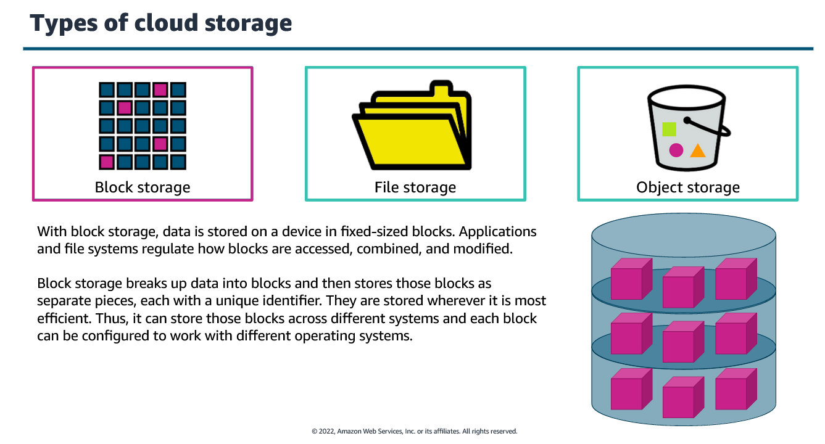
Cloud Storage

Slide 26
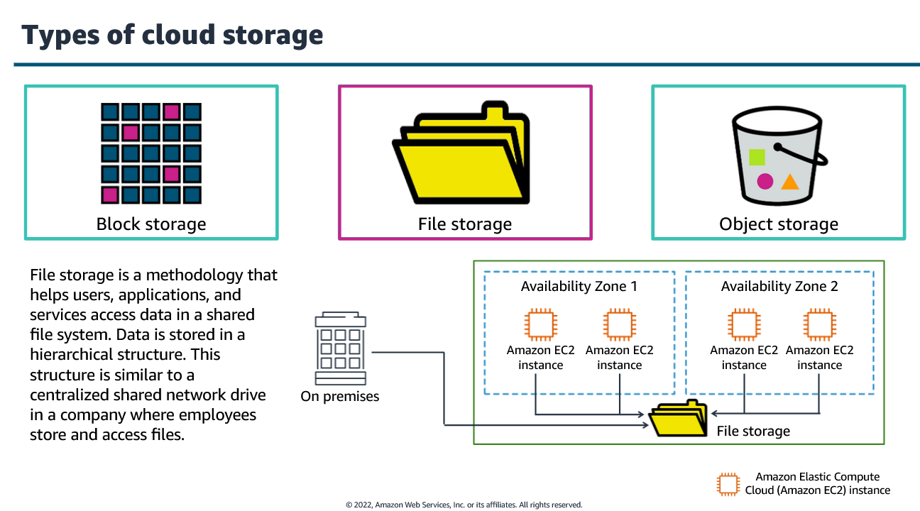
Cloud Storage

Slide 27
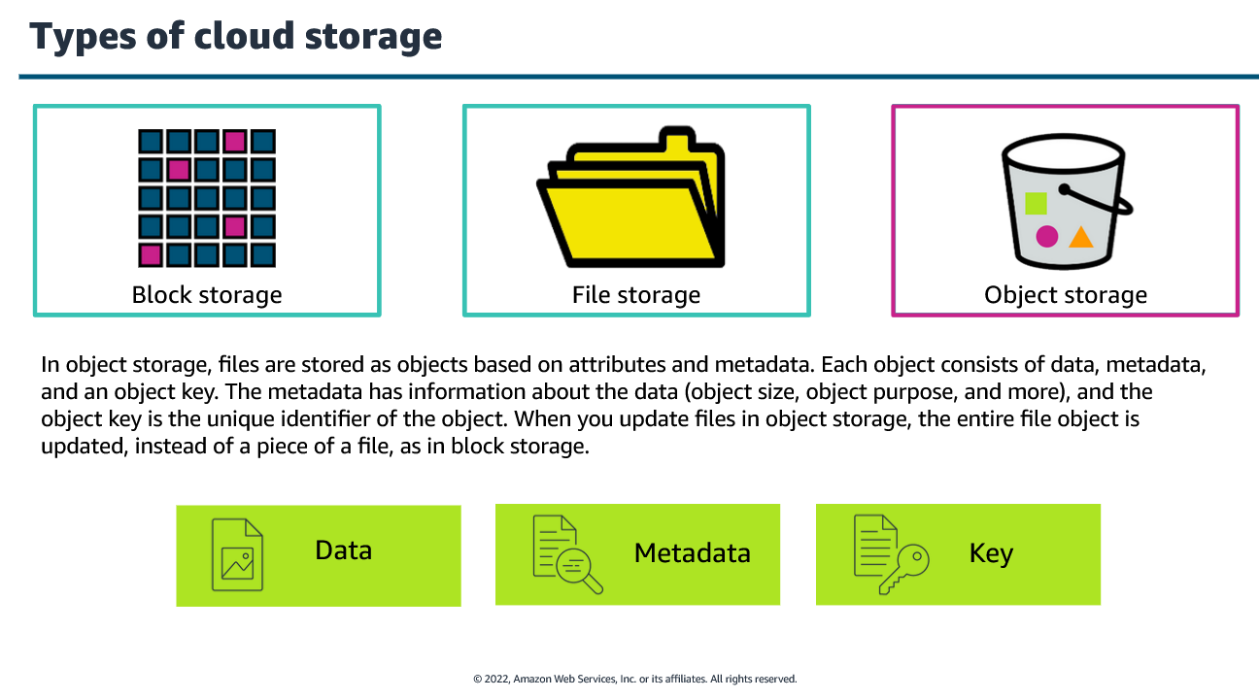
Cloud Storage

Slide 28
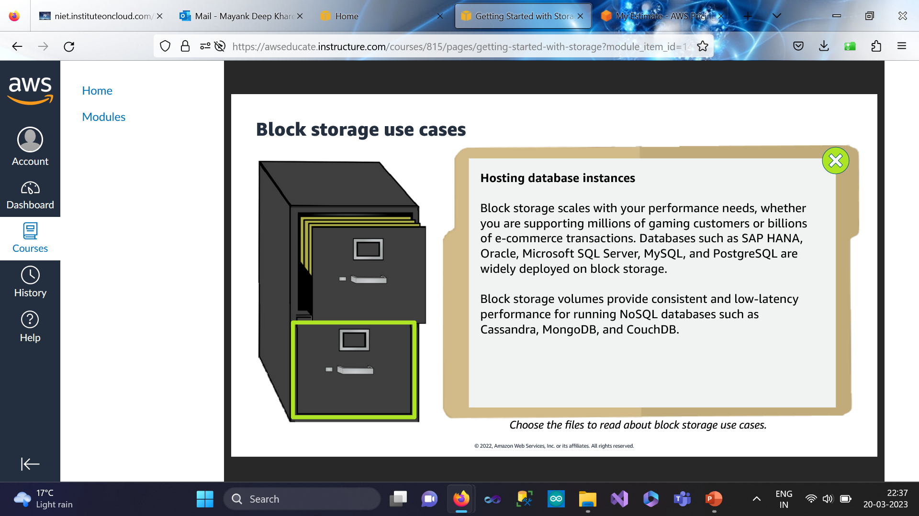
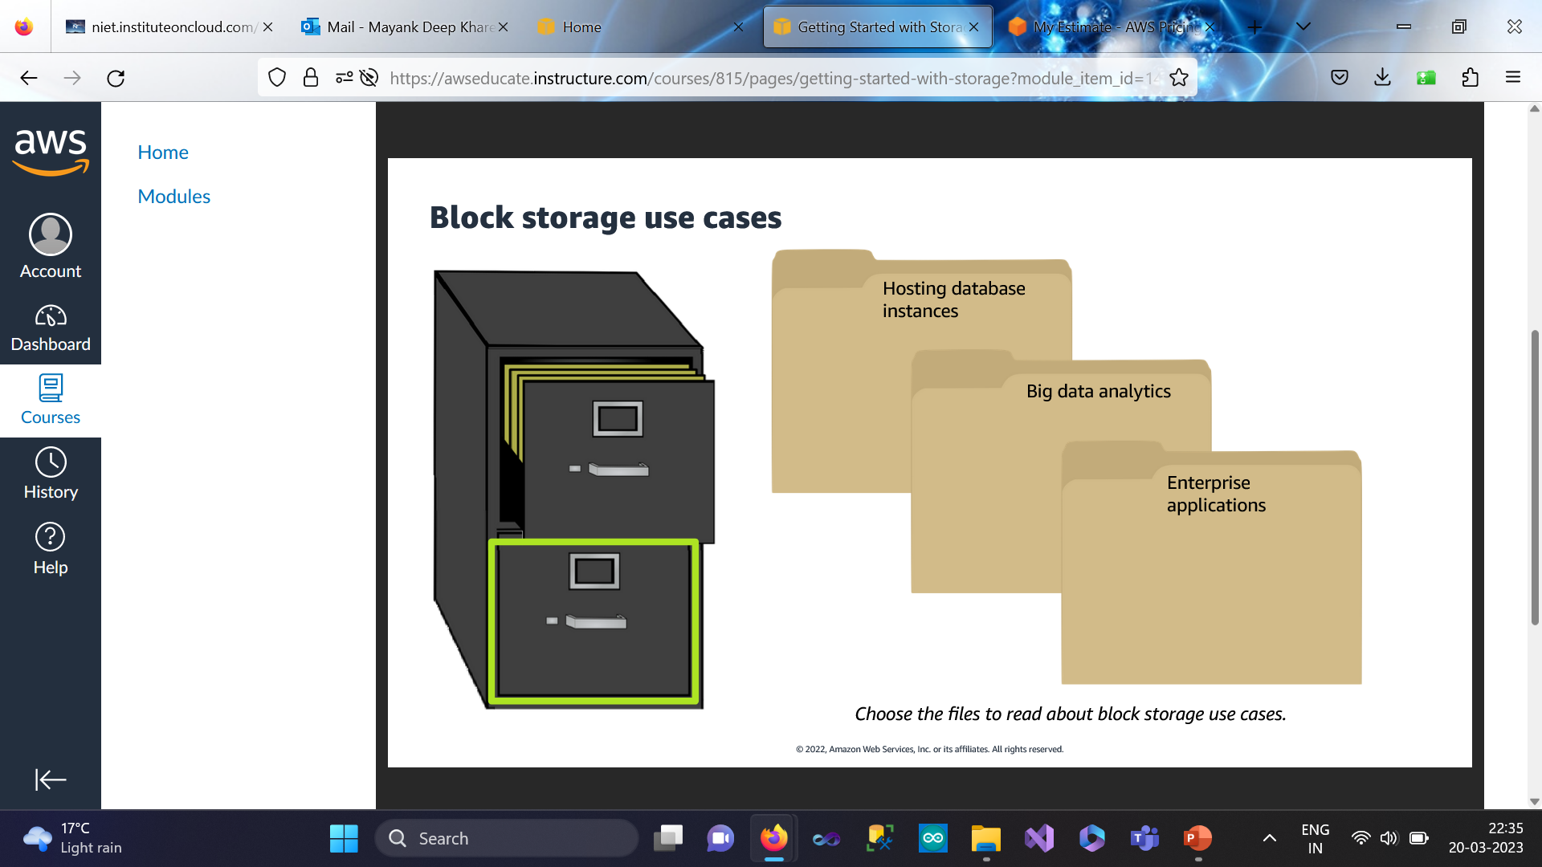

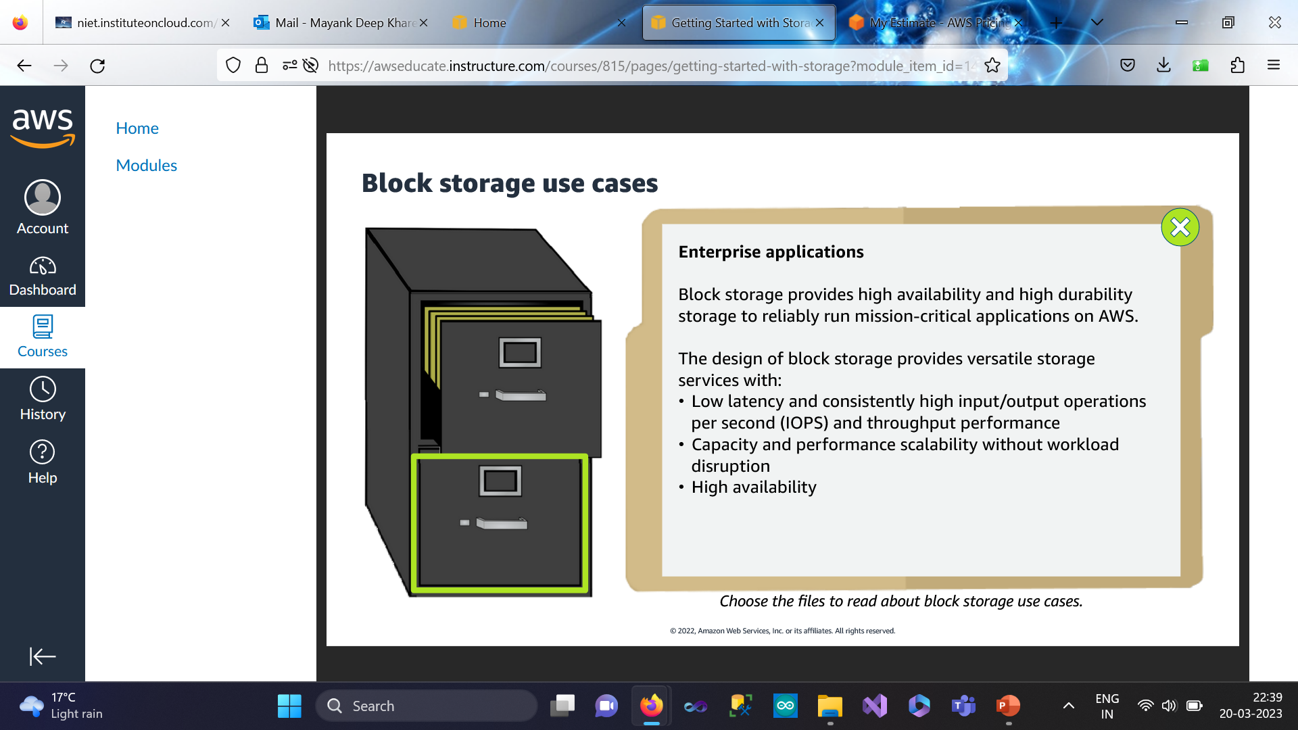
Cloud Storage

Slide 29
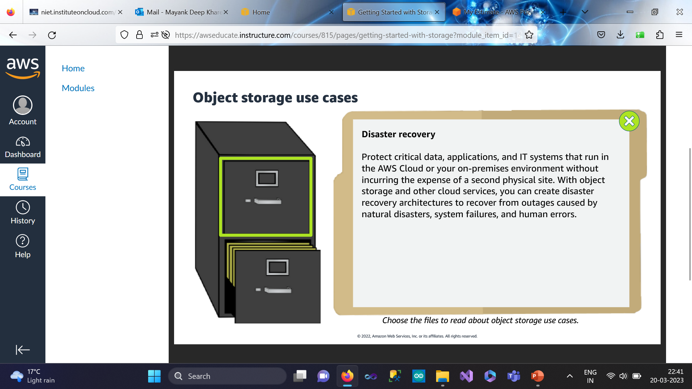
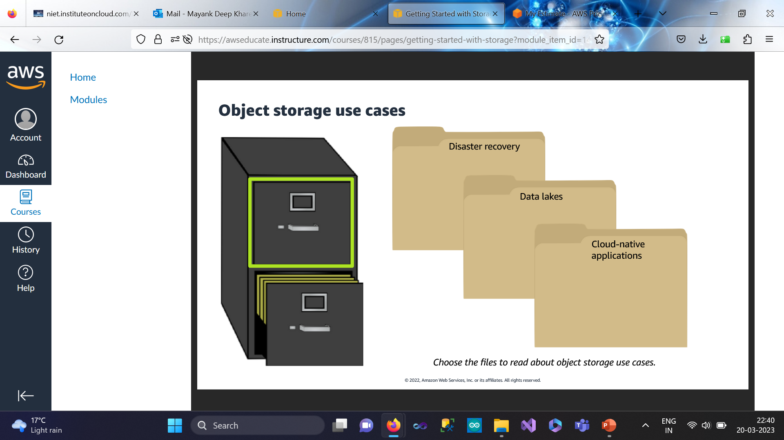
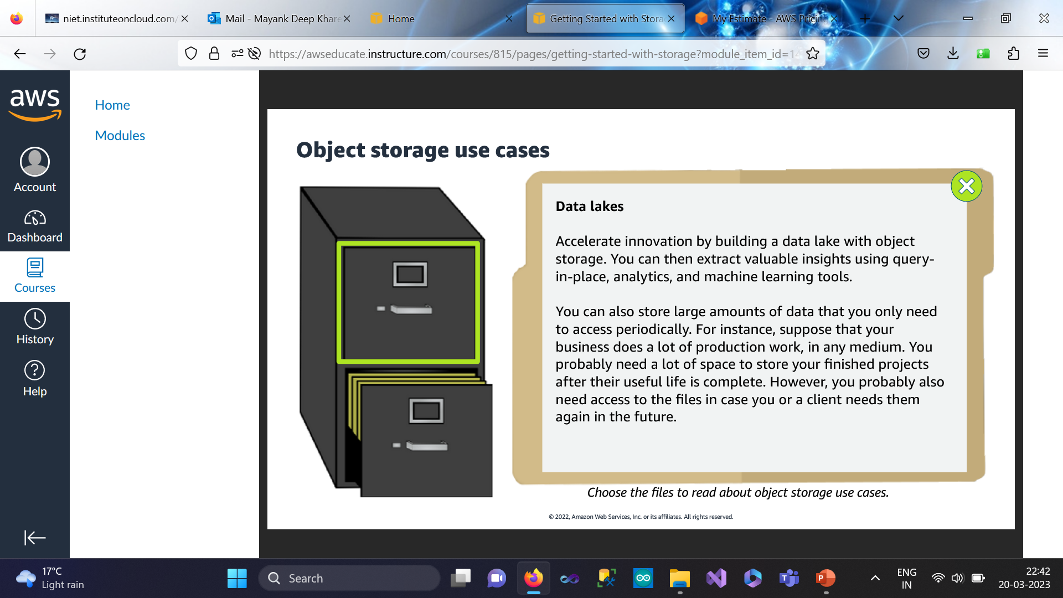
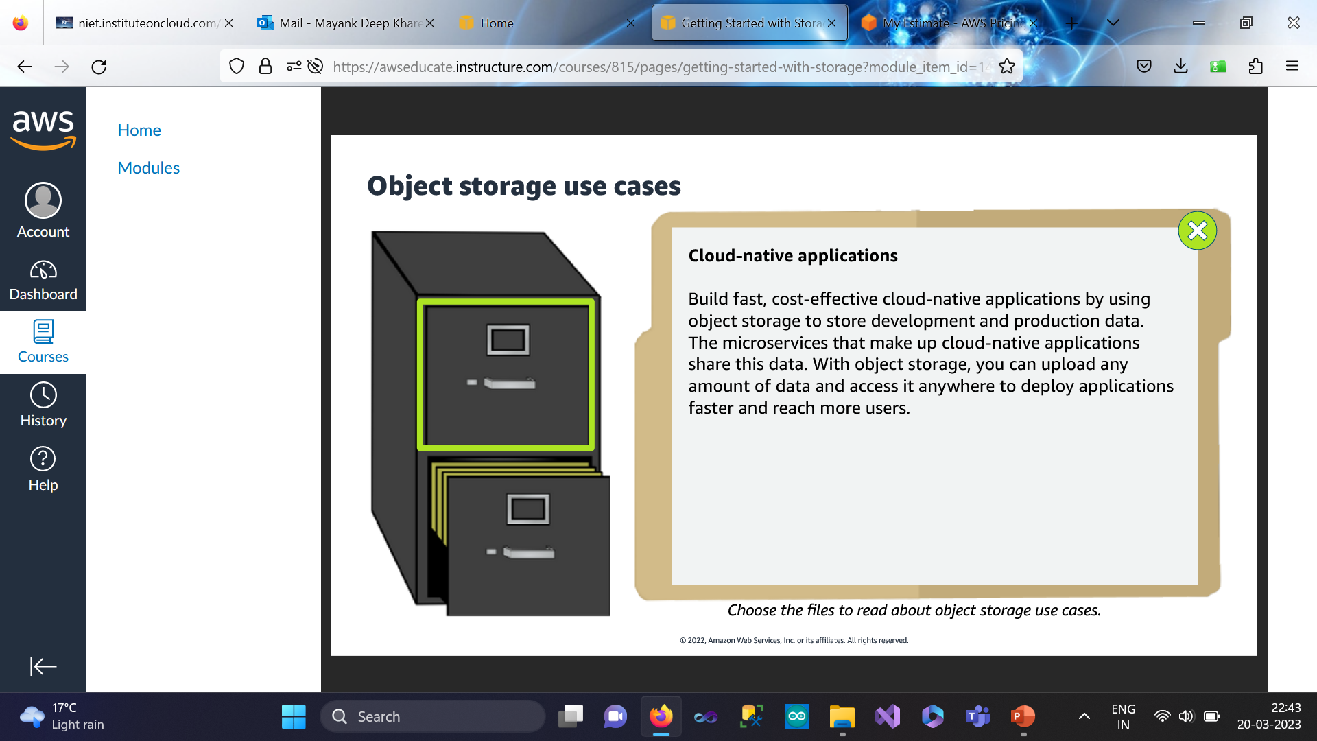
Cloud Storage

Slide 30
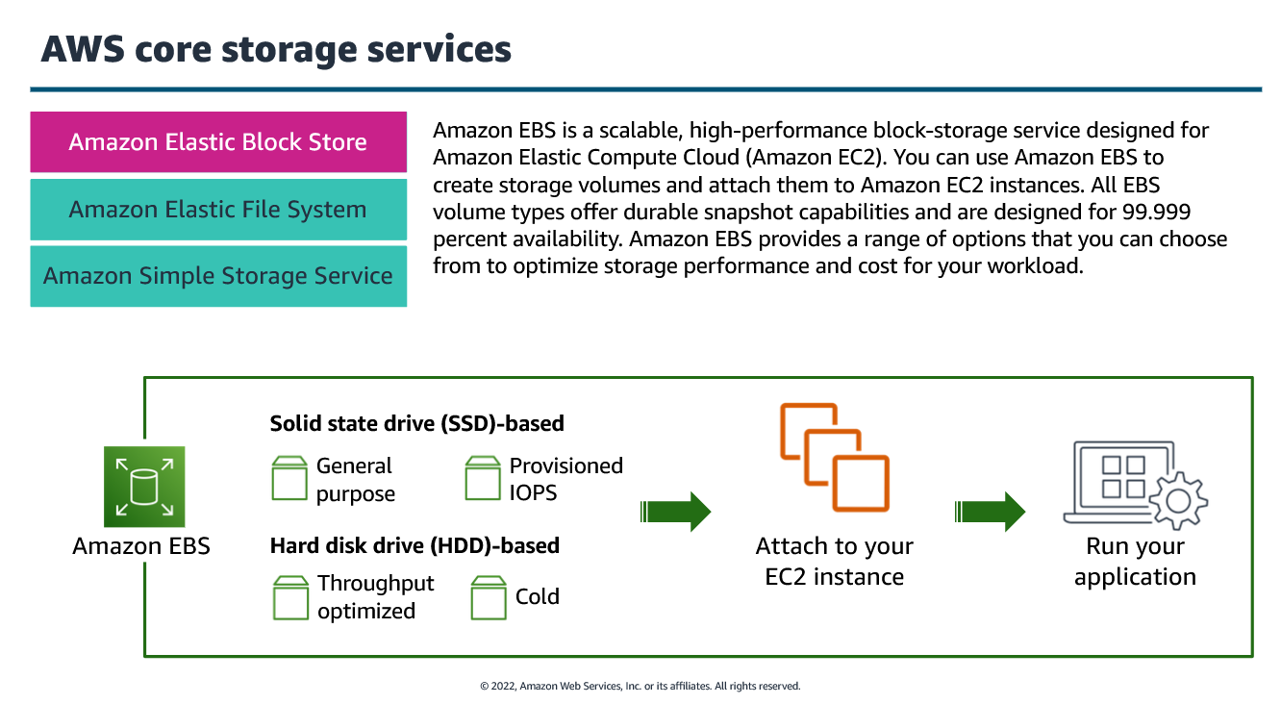
Cloud Storage

Slide 31
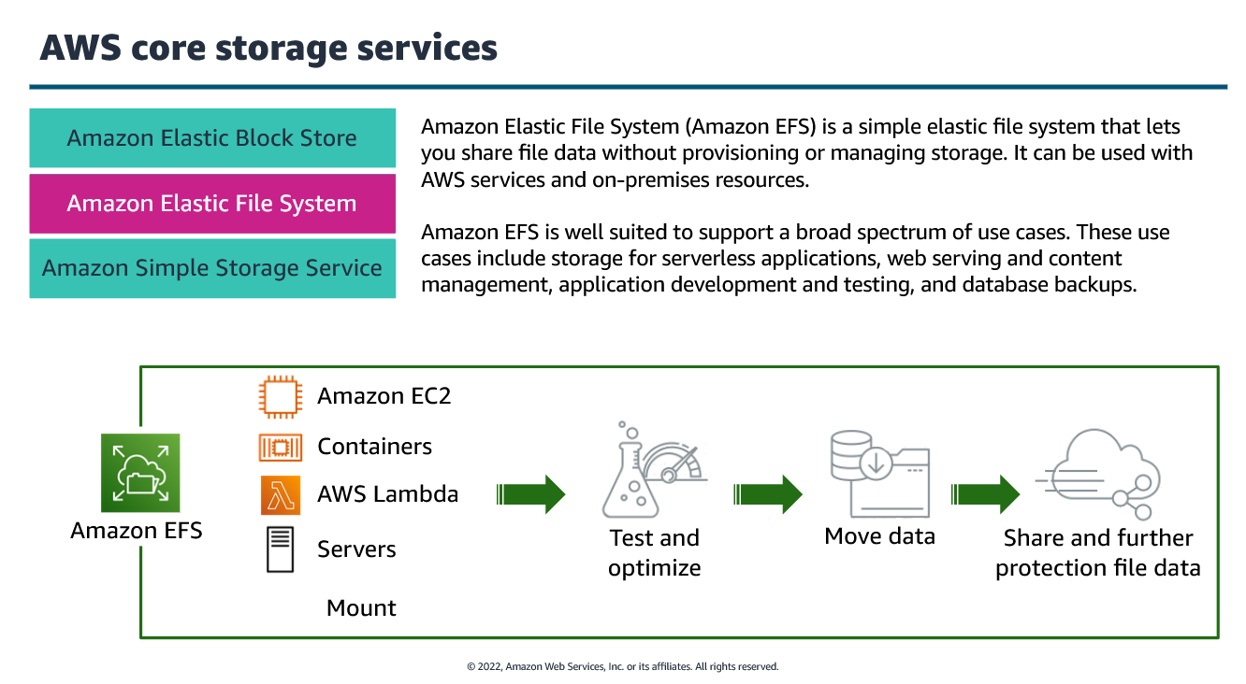
Cloud Storage

Slide 32
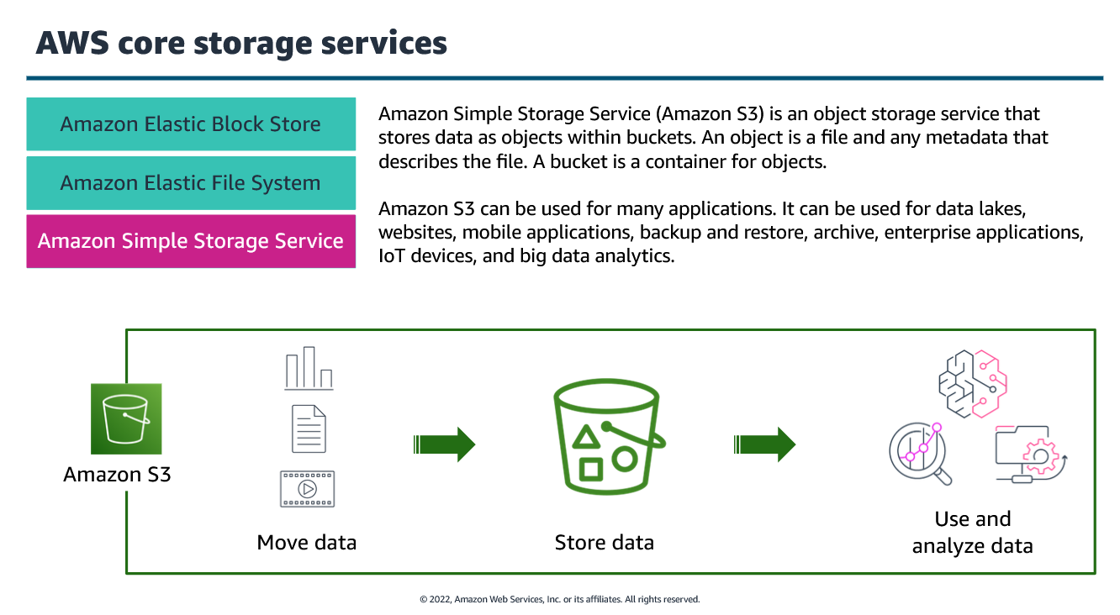
Cloud Storage

Slide 33
Storage as a Service
What Is Storage as a Service?
Storage as a Service or SaaS is cloud storage that you rent from a Cloud Service Provider (CSP) and that provides basic ways to access that storage.
Enterprises, small and medium businesses, home offices, and individuals can use the cloud for multimedia storage, data repositories, data backup and recovery, and disaster recovery.
There are also higher-tier managed services that build on top of STaaS, such as Database as a Service, in which you can write data into tables that are hosted through CSP resources.

Slide 34
Storage as a Service
The key benefit to SaaS is that you are offloading the cost and effort to manage data storage infrastructure and technology to a third-party CSP.
This makes it much more effective to scale up storage resources without investing in new hardware or taking on configuration costs.

Slide 35
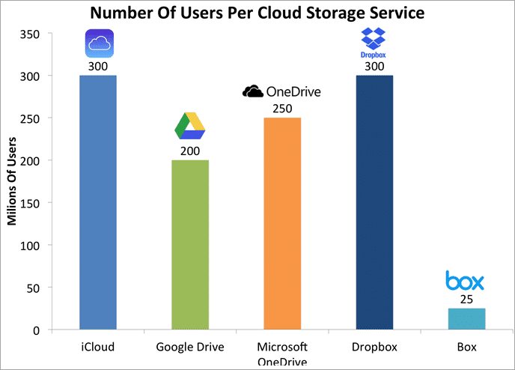
Storage as a Service
Fig: 4 Statistics details of Storage as a Service

Slide 36
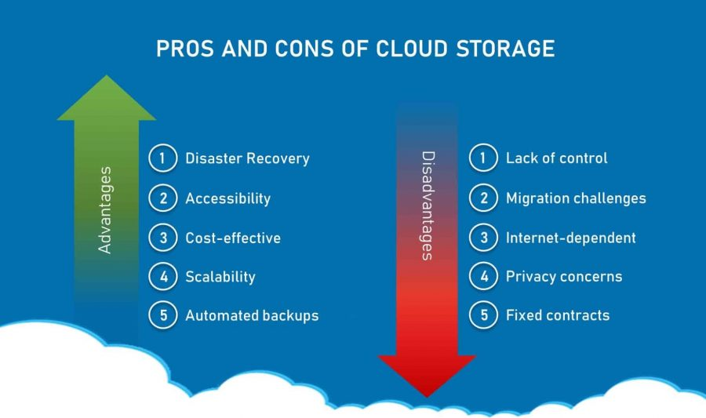
Advantages of Cloud Storage

Slide 37
Recap
Cloud Storage – Storage-as-a-Service
Advantages of Cloud Storage

Slide 38
Daily Quiz
1. What is the primary purpose of cloud storage? a) To store data on physical devices only b) To provide scalable and on-demand storage over the internet c) To restrict data access to a single user d) To eliminate the need for data security
Answer: b) To provide scalable and on-demand storage over the internet
3. Which of the following is NOT an advantage of cloud storage? a) Accessibility from any location with an internet connection b) Automatic backups and disaster recovery c) Unlimited free storage for all users d) Scalability to increase or decrease storage capacity as needed
Answer: c) Unlimited free storage for all users
2. What is Storage-as-a-Service (STaaS)? a) A service that provides storage solutions over the cloud on a subscription basis b) A local data storage method using external hard drives c) A security model for protecting data in cloud computing d) A cloud service that only allows data retrieval but not storage
Answer: a) A service that provides storage solutions over the cloud on a subscription basis
4. Which of the following is NOT a major cloud storage provider? a) Google Drive b) AWS S3 c) Microsoft OneDrive d) Adobe Photoshop
Answer: d) Adobe Photoshop

Slide 39
Cloud Storage Providers : S3,RDS,EBS
The traditional storage services have become extinct as cloud storage services come into the picture.
Elastic File Storage (EFS), Elastic Block Storage (EBS), and Simple Storage Service (S3) are AWS’s three different storage types that can be used for different types of workload needs.

Slide 40
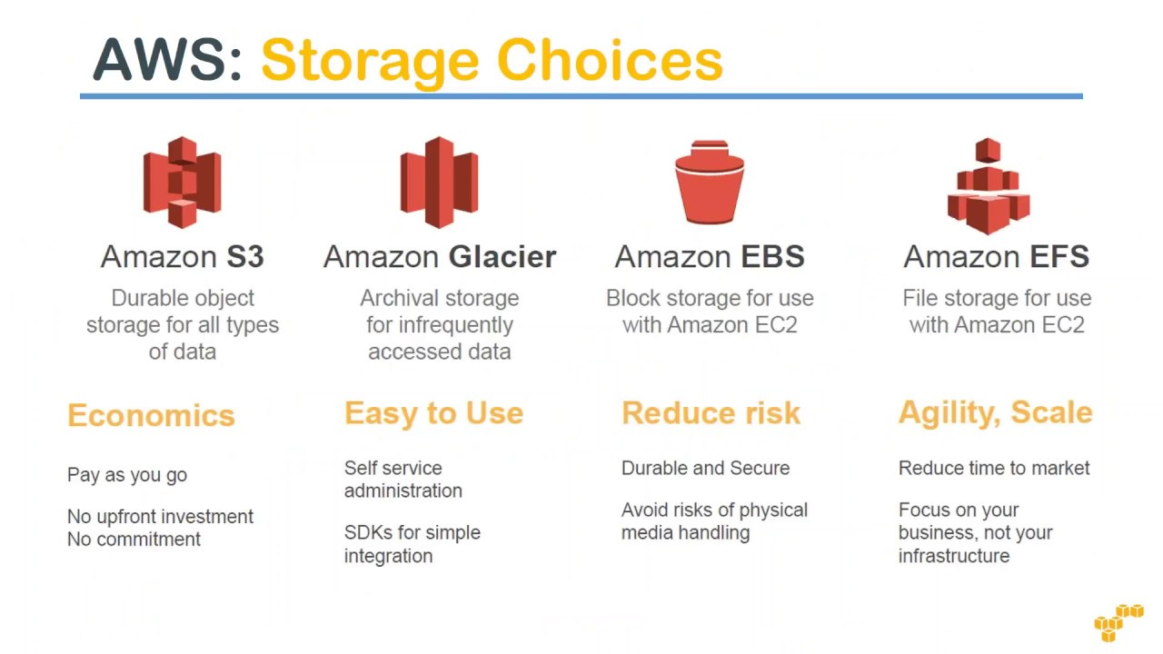
Cloud Storage Providers : S3,RDS,EBS
Amazon Storage Services

Slide 41
Cloud Storage Providers : S3,RDS,EBS
AWS S3 (Simple Storage Service)
AWS S3 stands for AWS Simple Storage Service. It is secure, durable, and highly scalable object storage which can store different types of files. It’s a static storage service useful for static website hosting, media distribution, version management, big data analytics, and archiving.
It is easy to use with a simple web interface to store and retrieve any amount of data from anywhere on the web. Files are stored in Buckets (similar to folders) and bucket names must be unique. Files can be from 0 bytes to 5TB.

Slide 42
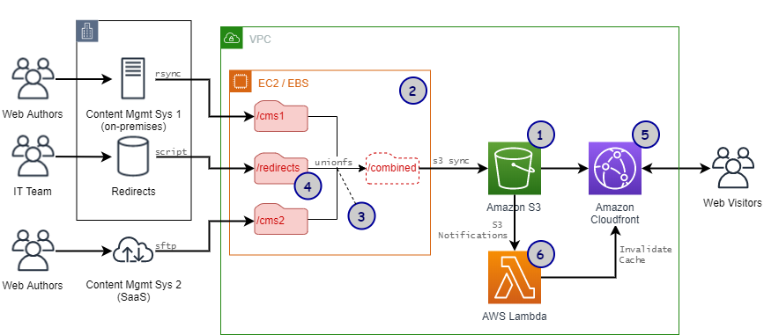
Cloud Storage Providers : S3,RDS,EBS
Fig 5: Amazon S3

Slide 43
Cloud Storage Providers : S3,RDS,EBS
What is Amazon RDS?
Amazon Relational Database Service (RDS) is a managed SQL database service provided by Amazon Web Services (AWS).
Amazon RDS supports an array of database engines to store and organize data. It also helps with relational database management tasks, such as data migration, backup, recovery and patching.

Slide 44
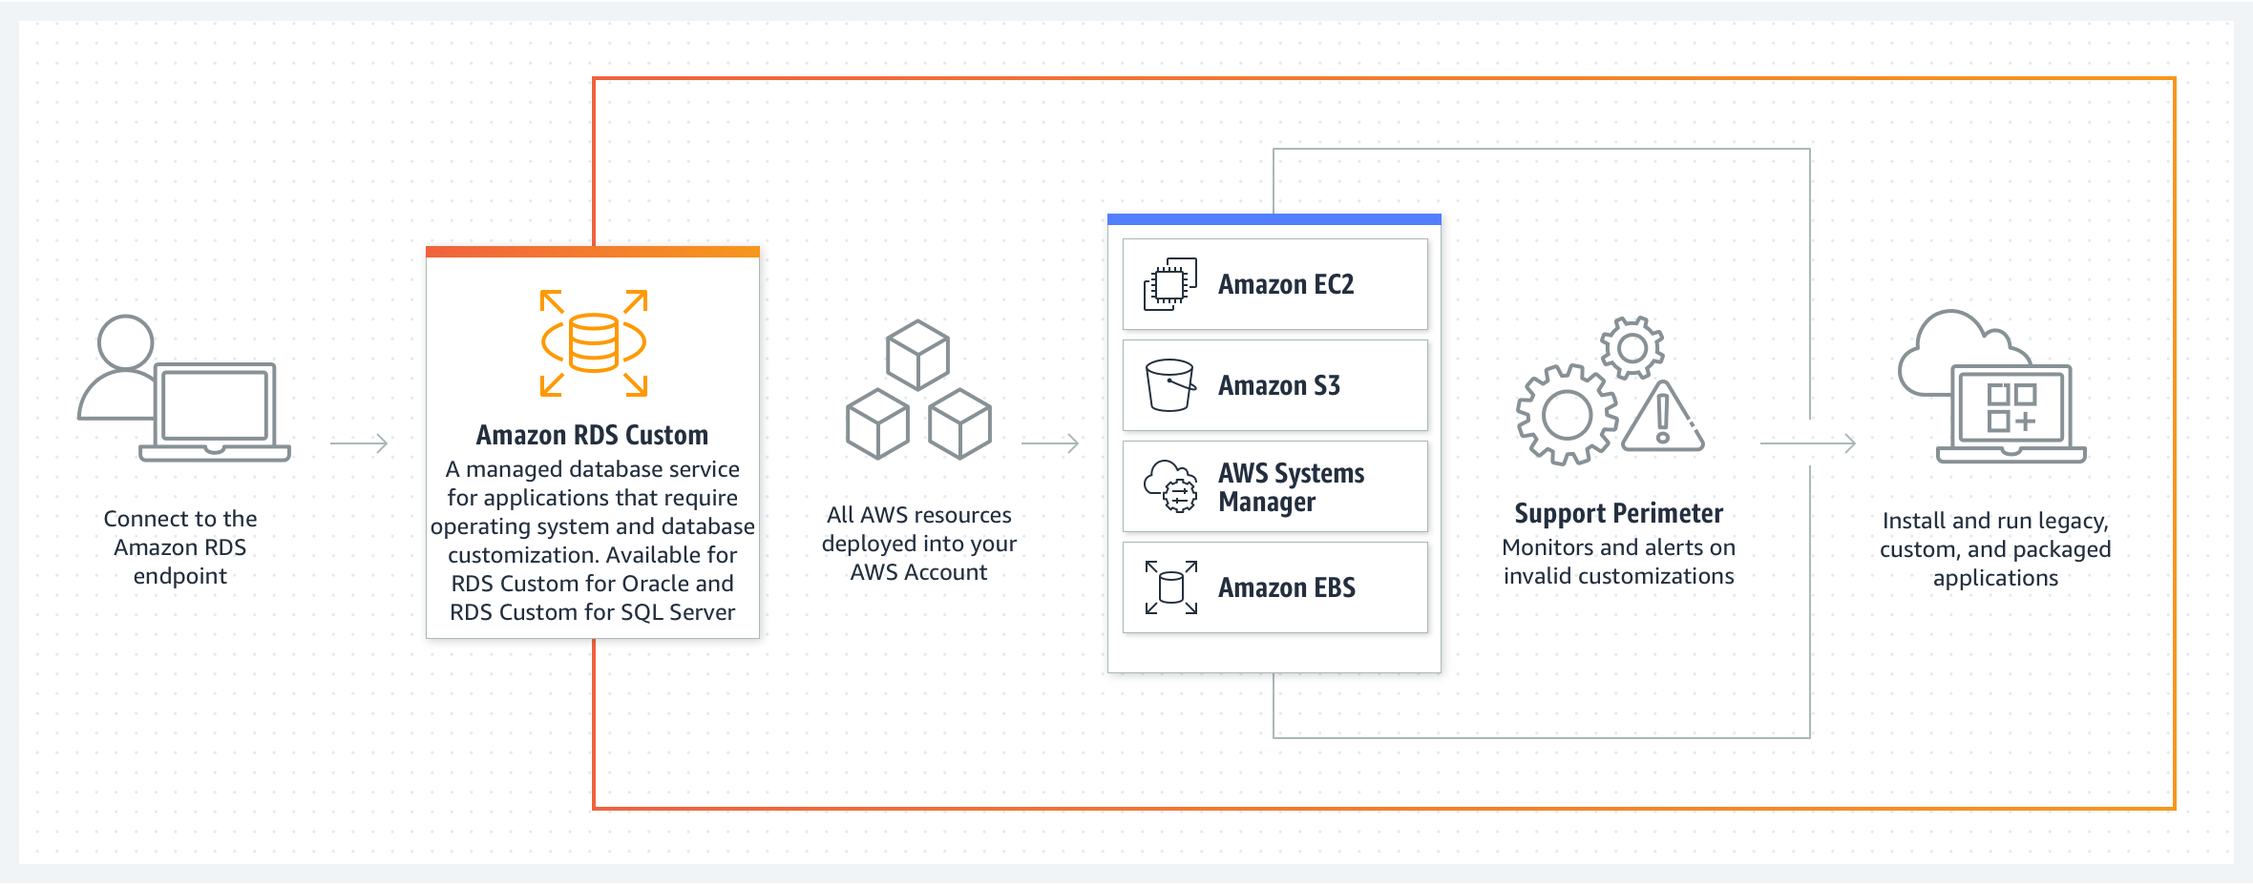
Cloud Storage Providers : S3,RDS,EBS
Fig 5: Amazon RDS

Slide 45
Cloud Storage Providers : S3,RDS,EBS
What is Elastic Block Storage (EBS)
Amazon Elastic Block Store (EBS) is an easy-to-use, high-performance block storage service designed for use with Amazon Elastic Compute Cloud (EC2) for both throughput and transaction-intensive workloads at any scale.
A broad range of workloads, such as relational and non-relational databases, enterprise applications, containerized applications, big data analytics engines, file systems, and media workflows are widely deployed on Amazon EBS.

Slide 46
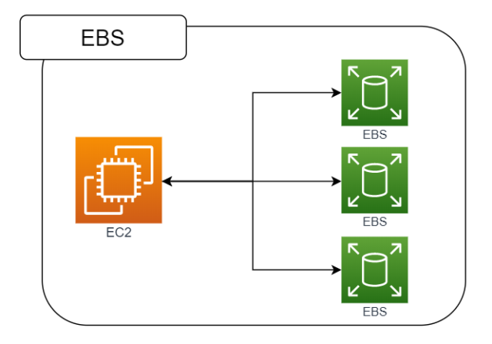
Cloud Storage Providers : S3,RDS,EBS
Fig 6: Amazon EBS

Slide 47
Recap
Cloud Storage Providers – S3, RDS, EBS.

Slide 48
Daily quiz
1. What does Amazon S3 primarily provide? a) Scalable object storage for various data types b) A database management system c) A computing service for running applications d) A virtual machine hosting service
Answer: a) Scalable object storage for various data types
3. How does Amazon EBS differ from S3? a) EBS is a block storage service, while S3 is an object storage service b) EBS provides global access, while S3 is only available locally c) EBS is used for backup purposes only d) EBS is a cloud database, while S3 is a computing service
Answer: a) EBS is a block storage service, while S3 is an object storage service
2. What is Amazon RDS used for? a) Managing relational databases in the cloud b) Providing block storage for virtual machines c) Hosting static websites d) Running containerized applications
Answer: a) Managing relational databases in the cloud
4. Which AWS service would you use for persistent block storage that can be attached to EC2 instances? a) Amazon S3 b) Amazon RDS c) Amazon EBS d) Amazon Glacier
Answer: c) Amazon EBS

Slide 49
MCQs
Salesforce is an example of ___________.
IaaS
PaaS
FaaS
None
2) Google App Engine is an example of _______.
IaaS
PaaS
FaaS
None
3) AWS EC2 is an example of _________.
IaaS
PaaS
FaaS
None

Slide 50
MCQs
4) SaaS Security practices include _________.
End-to-end data encryption
Data security at user level
VPN / VPC
All of the above
Google App Engine is a _________ cloud computing platform.
IaaS
PaaS
FaaS
None
6) Amazon EBS provides _________.
object storage solutions
file storage solutions
block storage solutions
all of the above

Slide 51

Previous Year Question Paper
2022-23
2023-24

Slide 52
Expected university question
Explain IaaS SaaS PaaS with examples?
What are the benefits and challenges to cloud architecture?
What are the major challenges in cloud and explain how do you overcome the challenges?
What are the disadvantages of cloud computing?
What are some major challenges with cloud computing?
What are advantages and disadvantages of cloud storage?
Explain system of systems applications and examples.
What is public/private hybrid cloud with example?
What is the difference in cloud computing and computing for mobiles?
Briefly state Storage-as-a-Service

Slide 53
Weekly assignment
Briefly explain S3 and EBS.
What is the difference between Amazon S3 and RDS?
Briefly state Storage-as-a-Service
What do you understand by Cloud Storage Providers.
State Architectural Design Challenges
Explain Layered Cloud Architecture Design
In cloud computing what are the different layers?
Explain the difference between cloud and traditional datacenters?
Explain what are the different modes of software as a service (SaaS)?
What are the security aspects provided with cloud?

Slide 54
Summary
This Unit consist of all the benefits of cloud and edge computing are-
Layered Cloud Architecture Design
NIST Cloud Computing Reference Architecture
Public Private & Hybrid Cloud
IaaS – PaaS - SaaS
Architectural Design Challenges
Cloud Storage
Storage as a Service
Advantages of Cloud Storage
Cloud Storage Providers : S3,RDS,EBS

Slide 55
Reference
https://en.wikipedia.org/wiki/Cloud_computing
https://www.javatpoint.com/cloud-computing
https://www.javatpoint.com/cloud-service-models
https://www.javatpoint.com/cloud-service-provider-companies
https://www.javatpoint.com/what-is-parallel-computing
https://www.geeksforgeeks.org/introduction-to-parallel-computing/
https://www.geeksforgeeks.org/evolution-of-cloud-computing/
https://www.slideshare.net/joyschandran/underlying-principles-of-parallel-and-distributed-computing
https://www.techslang.com/definition/what-is-cloud-provisioning/#:~:text=Also%20referred%20to%20as%20%E2%80%9Con,and%20down%20when%20demands%20decrease.

Slide 56

Thank You

